Slide 1

Basics of Dialogflow
SYNAPSE
03

Slide 2

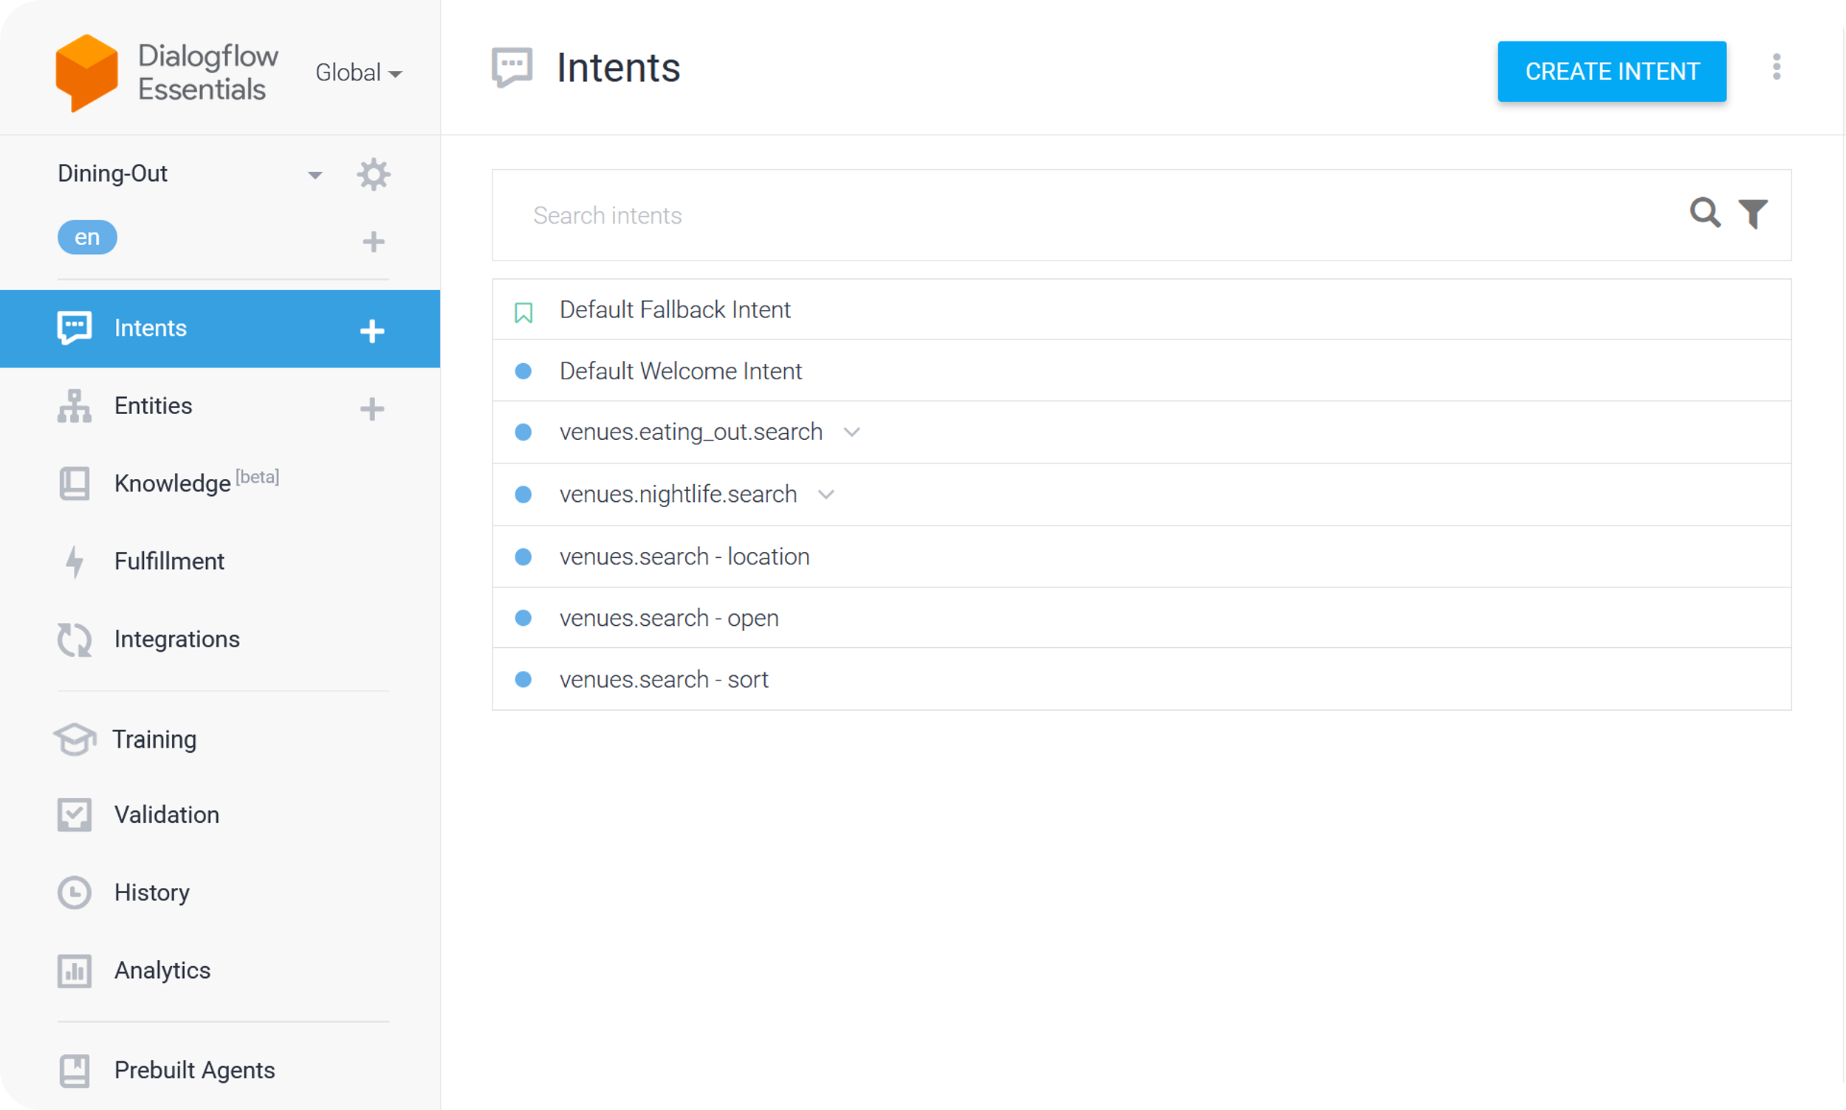
This is the central environment where developers design, build, and manage conversational agents (chatbots or virtual assistants).
They are essential for organizing and maintaining the conversational logic and content within Dialogflow ES.
Basic Workspace
03

Slide 3
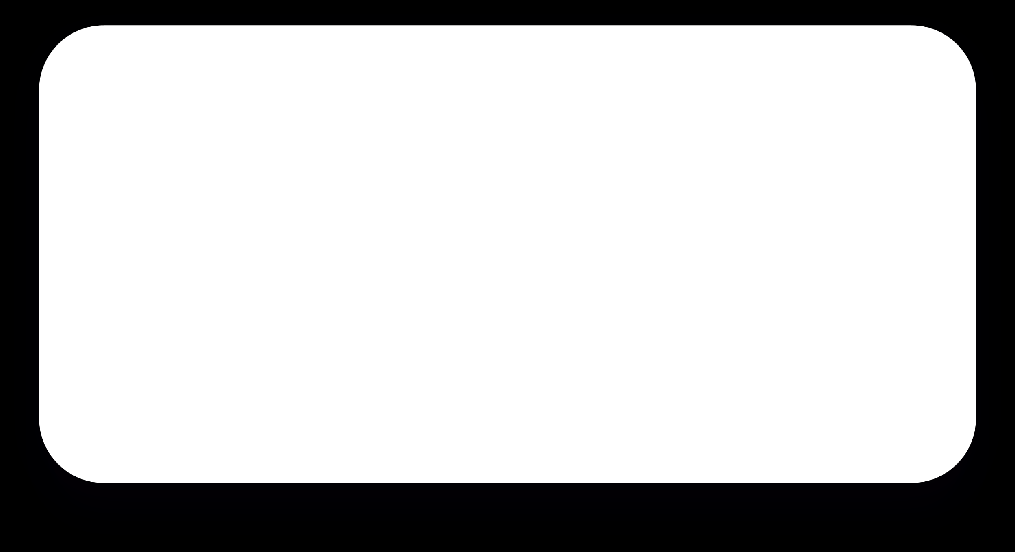

Training Phrases
Parameters
A list of example sentences or phrases that users might use to express their intentions. These training phrases help the AI understand and recognize user input.
Variables extracted from user input that provide important information, such as dates, locations, or names.
Responses
Fulfillments
The predefined messages or actions that the chatbot should generate as a reply to a user's request. These responses can include text, speech, or actions like calling an external API.
The code or logic that is executed when the intent is matched, which allows you to implement custom business logic, data retrieval, or other processing.
04

Slide 4


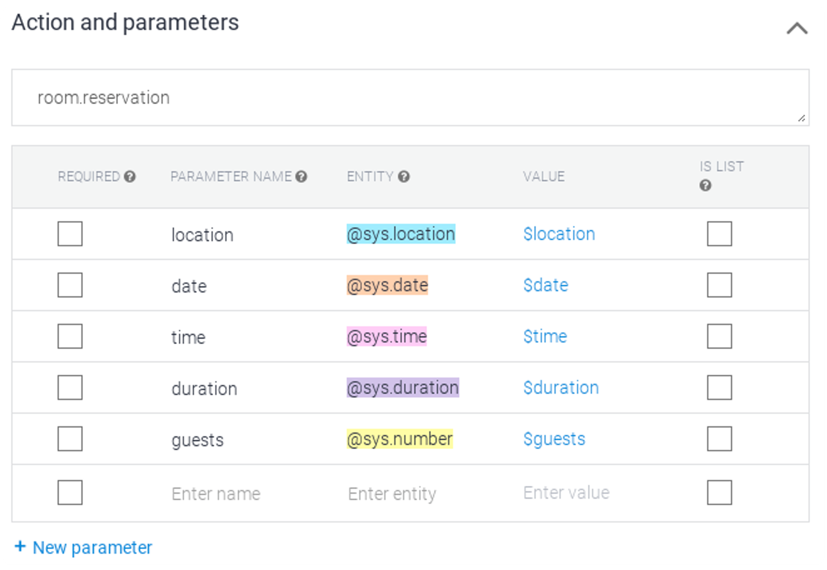

Parameters are variables used to extract and store specific pieces of information from user input during a conversation. Parameters enable the chatbot to generate relevant responses and perform actions. These extracted values can be utilized to customize responses and execute tasks.
Parameters
05

Slide 5
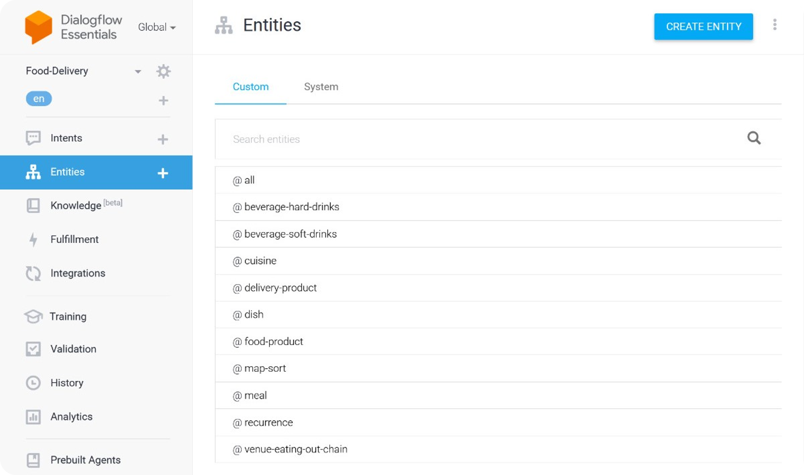
Entities in Dialogflow ES are placeholders for specific data types in user input.
They can be system-defined (like dates and numbers) or custom-defined, and they can have synonyms for variation.
06

Slide 6
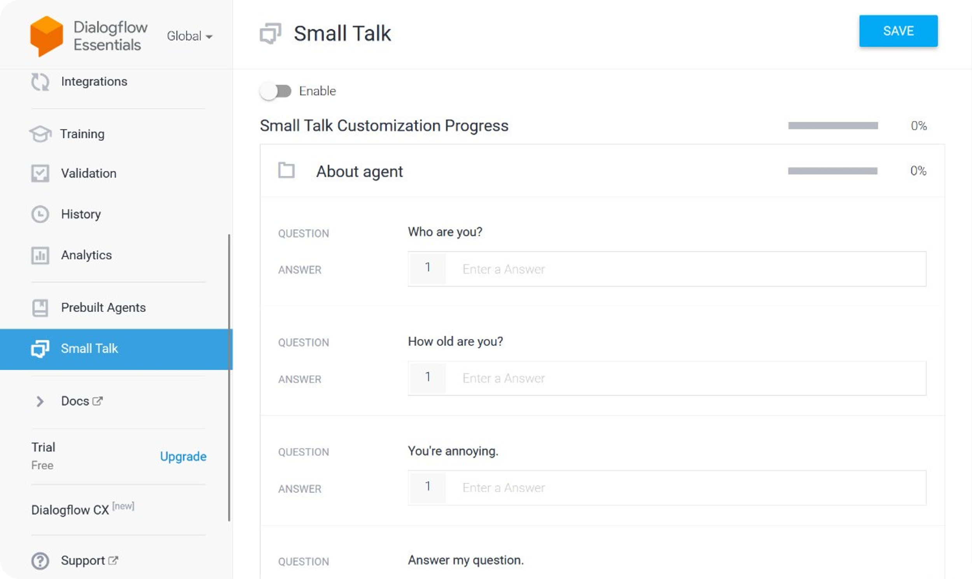
Small talk refers to a conversational feature that allows a chatbot to engage in casual and informal conversations with users.
With small talk enabled, a Dialogflow ES agent can respond to common conversational phrases, greetings, and social niceties.
07

Slide 7
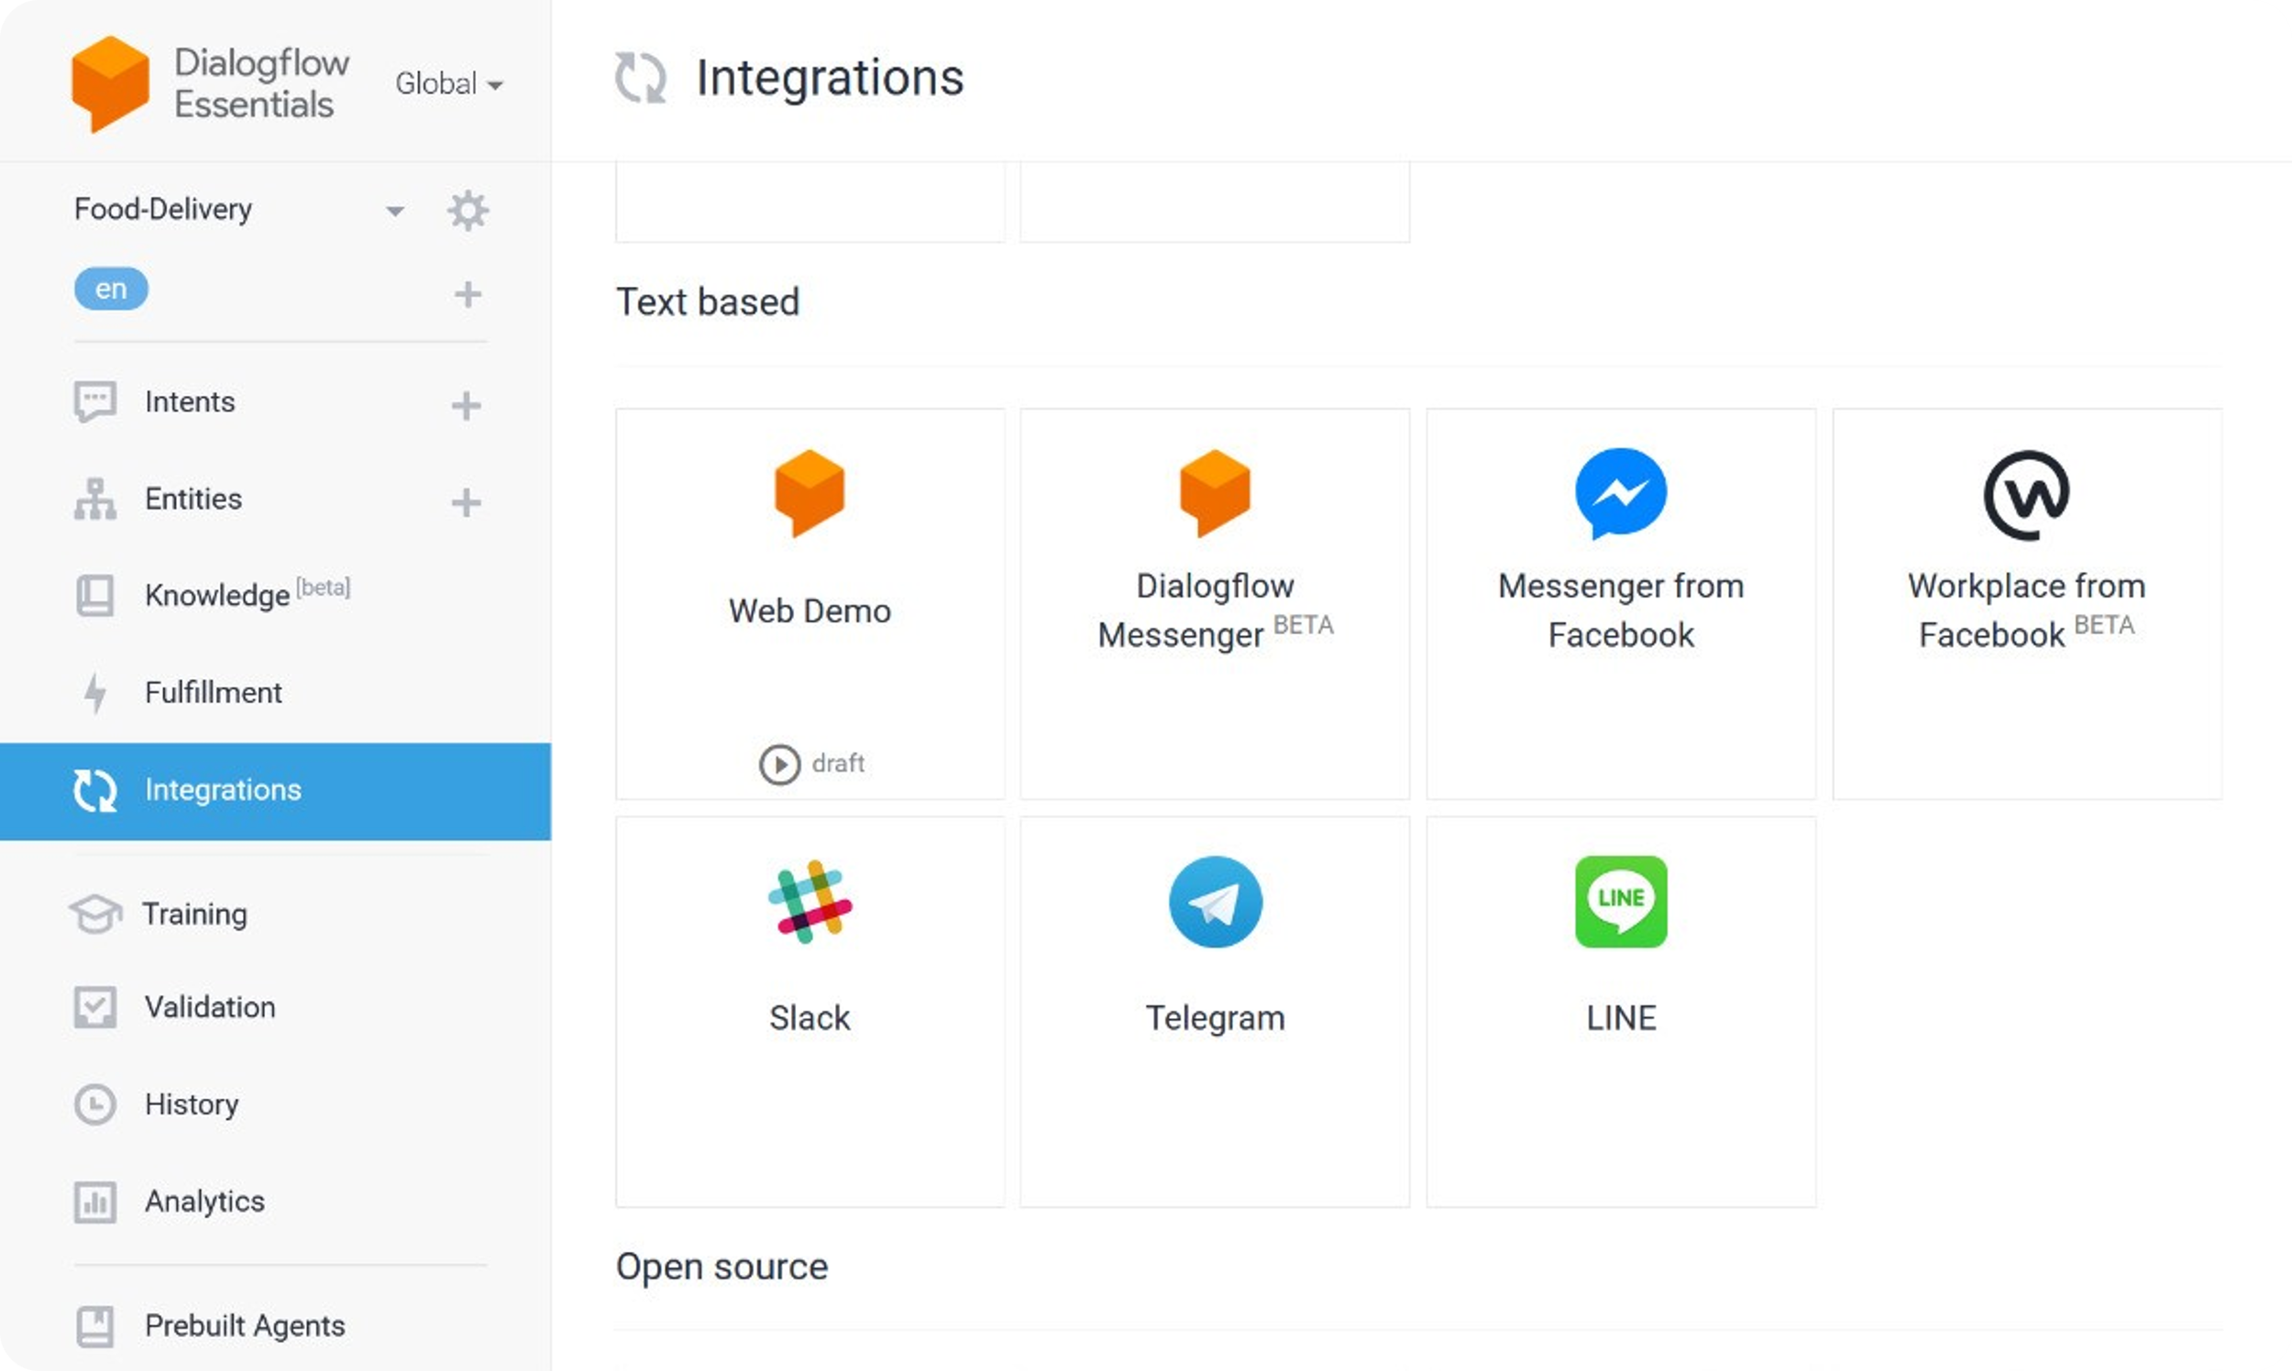
08

Slide 8
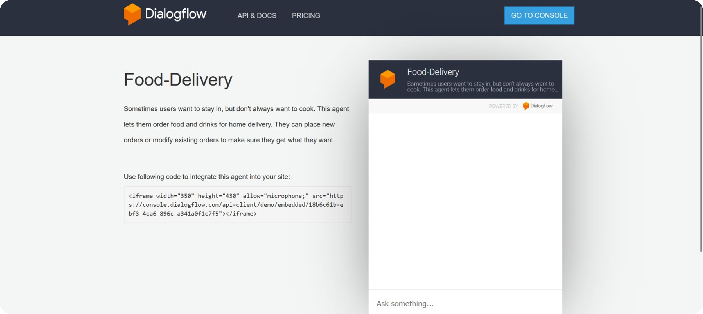
09

